Slide 1
Web Services (SOAP)

Slide 2
Overview - 1
Web Services
Conceptual Model of Web Services
Web Service Protocol Hierarchy
Web Service Protocols
Web Service Software Architecture
SOAP (Simple Object Access Protocol)
  SOAP Model
  SOAP Messages (XML Encoded)
  SOAP Request
  SOAP Response

Slide 3
Overview - 2
Developing Web Services (Apache SOAP)
  Software Required
  Existing Web Services
  Custom Web Services

Slide 4
Distributed Application Paradigms
Level of abstraction
Web Services
high
Object space, collaborative applications
network services, object request broker, mobile agent
remote procedure call, remote method invocation
Client-server, peer-to-peer
Message passing
low

Slide 5
Web Services - 1
Using this paradigm – application performs some of its tasks by making use of ready-made services available on the network.
Network services can be integrated dynamically, as they are required.
The paradigm has been extended to Web Services.

Slide 6
Web Services - 2
Network services provided over HTTP – “wired services” (i.e. transported by HTTP).
Promoted as a way to build network applications from distributed components (services) that are language and platform-independent.
Technologies are still evolving (i.e. protocols and API’s, XML-RPC, JSON-RPC).
We will now look at another protocol– SOAP (Simple Object Access Protocol).
We will also look at a sample API – Apache SOAP API.

Slide 7
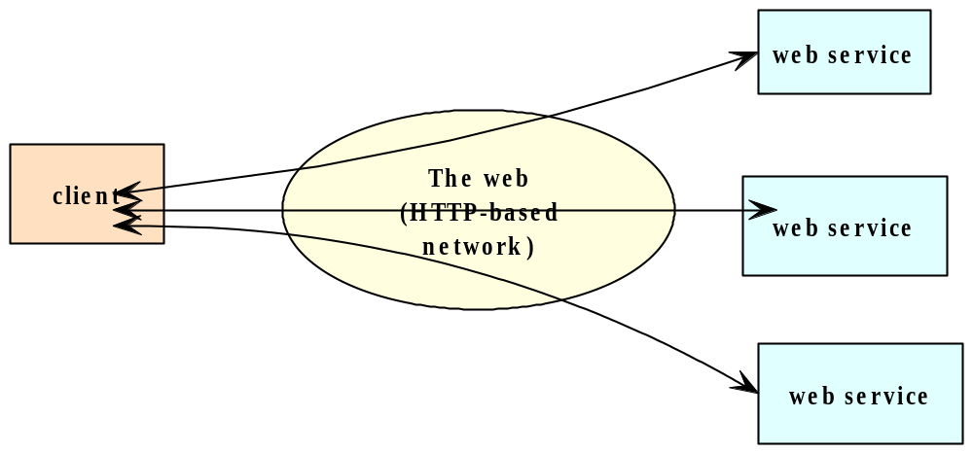
Conceptual Model of Web Services
Web service is provided by the server object & accessed by client.
Server and client exchange messages in accordance with standard protocols developed for web services.

Slide 8
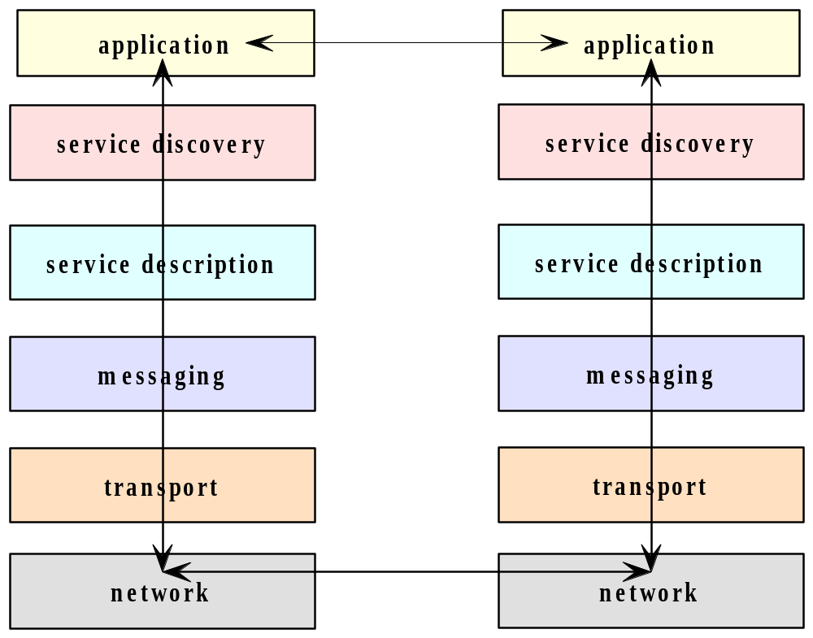
Web Service Protocol Hierarchy - 1

Slide 9
Web Service Protocol Hierarchy - 2
Logically, the server and client exchange messages at the application layer.
Physically, a series of protocols, at various layers, are required to support the message exchange:
  Service discovery layer – allows the service to be registered and located.
  Service description layer – allows service to be described to the directory.
  Messaging layer - supports the mechanisms for interprocess communications (including functionalities of data marshalling).
  Transport layer – Delivers the messages.
  Network layer – represents the network protocol hierarchy for the physical transmission and routing of data packets.

Slide 10
Web Service Protocols
Application
Service discovery
UDDI (Universal Description, Discovery, and Integration, Consul etcd)
Service description
WSDL (Web Service Description Language)
Syntax and semantics for describing services, RSDL, WADL etc
Messaging
XML-RPC, JSON-RPC, SOAP (Simple Object Access Protocol)
XML encoded messages (REST)
Transport
TCP , HTTP, SMTP , Jabber
Network
IP Network layer protocol

Slide 11
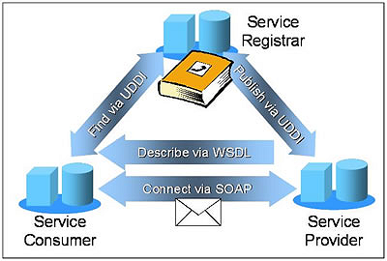
Web Service Overview
Source : http://roadmap.cbdiforum.com/reports/protocols/

Slide 12
Web Service Software Architecture
Service listener on the server host listens for service requests transmitted over the web.
When a request is received – forwarded to a proxy for the service.
Proxy invokes the application logic in the service object and relays the return value to the caller.
Application
Service
Service
service
logic
proxy
listener
request

Slide 13
SOAP (Simple Object Access Protocol)
See Web Services protocol diagram above.
SOAP is a protocol that incorporates the distributed objects paradigm and Internet protocols.
Applies XML for message exchange in support of remote method calls over the Internet.
Extends HTTP to allow access to distributed objects that represent web services – RPC over HTTP usually (Note: Message passing also possible).
Compared to remote method invocation or RPC facilities:
  SOAP is web-based - not subject to firewall restrictions.
  Language-independent.
  Can provide just-in-time service integration.

Slide 14
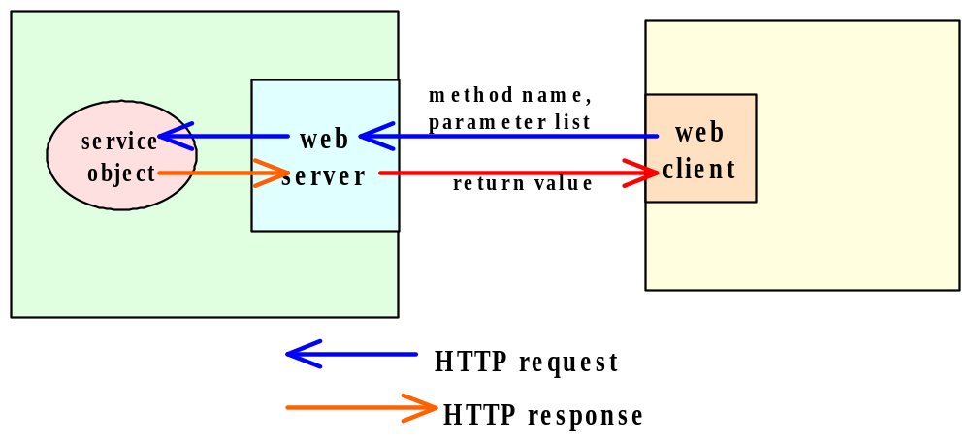
SOAP Model - 1
Including SOAP message
SOAP Request
SOAP Response
Remote Procedure Call (RPC) using HTTP

Slide 15
SOAP Model - 2
Web client issues an HTTP request, the body of which contains a SOAP formatted message that represents a method call to a service object.
Request is transmitted to a web server, which forwards the request, along with parameters for the method call to the named method.
Method is then invoked.
Upon completion, the value returned by the method is sent to the web server and then transmitted to the web client in the body of an HTTP response.

Slide 16
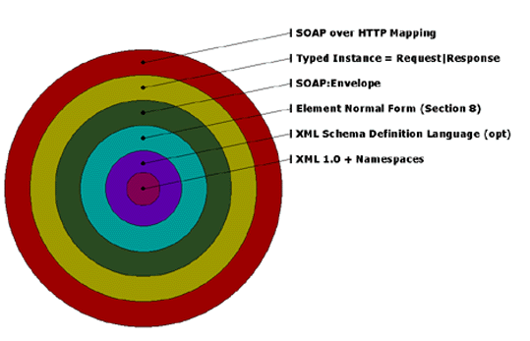
SOAP Layers
Source : http://www.xml.com/lpt/a/2000/02/09/feature/index.html

Slide 17
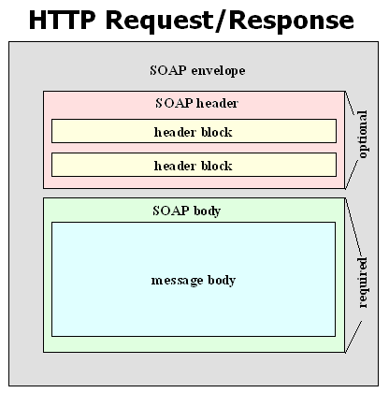
SOAP Messages (XML Encoded)

Slide 18
SOAP Request (HTTP + SOAP) - 1
POST /examples HTTP/1.1
User-Agent: Radio UserLand/7.0 (WinNT)
Host: localhost:81
Content-Type: text/xml; charset=utf-8
Content-length: 474
SOAPAction: "/examples"
<?xml version="1.0"?>
<SOAP-ENV:Envelope SOAP ENV:encodingStyle=
"http://schemas.xmlsoap.org/soap/encoding/"
xmlns:SOAP-ENC=http://schemas.xmlsoap.org/soap/encoding/
xmlns:SOAP-ENV=http://schemas.xmlsoap.org/soap/envelope/
xmlns:xsd=http://www.w3.org/1999/XMLSchema
xmlns:xsi="http://www.w3.org/1999/XMLSchema-instance">
<SOAP-ENV:Body>
<m:getStateName xmlns:m="http://www.soapware.org/">
<statenum xsi:type="xsd:int">41</statenum>
</m:getStateName>
</SOAP-ENV:Body>
</SOAP-ENV:Envelope>
See http://www.soapware.org/bdg

Slide 19
SOAP Request (HTTP + SOAP) - 2
Components:
  HTTP Request Header.
  SOAPAction header line.
  Request Body.
    SOAP Envelope.
    SOAP Body.

Slide 20
SOAP Request (HTTP + SOAP) - 3
HTTP Request Header:
  URI in the HTTP header specifies the object to which the remote method call is directed.
  Example: remote object is /examples.
  User agent and host must be specified
  Content-type – text/xml.
  Charset = specification of character representation employed:
    Default – US-ASCII; Unicode encoding - UTF-8, UTF-16.
SOAPAction Header line:
  Specifies the remote object to which the request is being directed to.
  Interpretation up to the program.
  Normally the URI specified on first line and SOAPAction will have the same name.

Slide 21
SOAP Request (HTTP + SOAP) - 3
Request Body:
<SOAP-ENV:Envelope SOAP ENV:encodingStyle=
"http://schemas.xmlsoap.org/soap/encoding/"
xmlns:SOAP-ENC=http://schemas.xmlsoap.org/soap/encoding/
xmlns:SOAP-ENV=http://schemas.xmlsoap.org/soap/envelope/
xmlns:xsd=http://www.w3.org/1999/XMLSchema
xmlns:xsi="http://www.w3.org/1999/XMLSchema-instance">
<SOAP-ENV:Body>
<m:getStateName xmlns:m="http://www.soapware.org/">
<statenum xsi:type="xsd:int">41</statenum>
</m:getStateName>
</SOAP-ENV:Body>
</SOAP-ENV:Envelope>
SOAP Envelope
SOAP Body
SOAP Envelope – Element contains set of required attributes for encoding scheme & envelope style.
SOAP Body – Method call – method name, name of each parameter, value and data type each parameter.

Slide 22
SOAP Response (HTTP + SOAP) - 1
HTTP/1.1 200 OK
Connection: close
Content-Length: 499
Content-Type: text/xml; charset=utf-8
Date: Wed, 28 Mar 2001 05:05:04 GMT
Server: UserLand Frontier/7.0-WinNT
<?xml version="1.0"?>
<SOAP-ENV:Envelope SOAP-ENV:encodingStyle="http://schemas.xmlsoap.org/soap/encoding/" xmlns:SOAP-ENC="http://schemas.xmlsoap.org/soap/encoding/" xmlns:SOAP-ENV="http://schemas.xmlsoap.org/soap/envelope/" xmlns:xsd="http://www.w3.org/1999/XMLSchema" xmlns:xsi="http://www.w3.org/1999/XMLSchema-instance">
<SOAP-ENV:Body>
<m:getStateNameResponse xmlns:m="http://www.soapware.org/">
<Result xsi:type="xsd:string">South Dakota</Result>
</m:getStateNameResponse>
</SOAP-ENV:Body>
</SOAP-ENV:Envelope>
http://www.soapware.org/bdg

Slide 23
SOAP Response (HTTP + SOAP) - 2
Similar to the SOAP Request.
Components:
  HTTP Response Header.
  Response Body.
    SOAP Envelope.
    SOAP Body.

Slide 24
SOAP Response (HTTP + SOAP) - 3
HTTP Response Header:
HTTP/1.1 200 OK
Connection: Close
Content-Length:499
Content-Type: text/xml; charset=utf-8
Date: Wed, 28 Mar 2001 05:05:04 GMT
Server: UserLand Frontier/7.0-WinNT

Slide 25
SOAP Response Success
Method name
Response Body:
<SOAP-ENV:Envelope SOAP-ENV:encodingStyle="http://schemas.xmlsoap.org/soap/encoding/" xmlns:SOAP-ENC="http://schemas.xmlsoap.org/soap/encoding/" xmlns:SOAP-ENV="http://schemas.xmlsoap.org/soap/envelope/" xmlns:xsd="http://www.w3.org/1999/XMLSchema" xmlns:xsi="http://www.w3.org/1999/XMLSchema-instance">
<SOAP-ENV:Body>
<m:getStateNameResponse xmlns:m="http://www.soapware.org/">
<Result xsi:type="xsd:string">South Dakota</Result>
</m:getStateNameResponse>
</SOAP-ENV:Body>
</SOAP-ENV:Envelope>
SOAP Envelope
Server name
SOAP Body
Returned value
SOAP Envelope – Element contains set of required attributes for encoding scheme & envelope style.
SOAP Body – Success or Failure - Element- Method name + word response ; result subelement contains the returned data – both value & data type.

Slide 26
SOAP Response – Failure - 1
A call to a SOAP method can fail – errors in the specification of the method name or parameters.
When a method call cannot be completely successful the HTTP response contains a SOAP body that defines a fault code and the fault string.
See example on next slide.

Slide 27
SOAP Response – Failure - 2
HTTP/1.1 500 Server Error
Connection: close
Content-Length: 511
Content-Type: text/xml; charset=utf-8
Date: Wed, 28 Mar 2001 05:06:32 GMT
Server: UserLand Frontier/7.0-WinNT
<?xml version="1.0"?>
<SOAP-ENV:Envelope SOAP-ENV:encodingStyle="http://schemas.xmlsoap.org/soap/encoding/" xmlns:SOAP-ENV="http://schemas.xmlsoap.org/soap/envelope/" xmlns:xsd="http://www.w3.org/1999/XMLSchema" xmlns:xsi="http://www.w3.org/1999/XMLSchema-instance">
<SOAP-ENV:Body>
<SOAP-ENV:Fault>
<faultcode>SOAP-ENV:Client</faultcode>
<faultstring>Can't call getStateName because there are too many
parameters.</faultstring>
</SOAP-ENV:Fault>
</SOAP-ENV:Body>
</SOAP-ENV:Envelope>
Fault Code
Fault String
Fault

Slide 28
Developing Web Services
Software required.
We will examine two types of application:
  Existing Web Services
    SOAP server & associated Service profile.
    Web service client.
  Custom Web Services
    Web Service (SOAP) server
    Web Service Client.

Slide 29
Software Required -1
Writing code to directly generate the XML syntax for SOAP requests and responses – tedious & error-prone.
Numerous API’s and Frameworks for SOAP exist.
Provide the necessary abstraction to facilitate programming involving SOAP requests and responses.
Software requirements (in terms of installation) differ – are you invoking a service or creating a new one ?

Slide 30
Software Required - 2
Examples:
  JAX-WS
  Apache SOAP
  SOAP::Lite – Perl programming.
  Microsoft’s .NET supports SOAP – WCF
  Python

Slide 31
Existing Web Services - 1
Idea of Web services is to allow software developers to make use of ready-made services.
Such services range form profiting-making services by commercial vendors to free services provided by a user community.
Number of free web services are currently available. Lists are provided, some of which may be found at:
  http://www.programmableweb.com
Most Social Media and other Web companies make their services available via Web Services Protocols (mostly SOAP, REST)

Slide 32
Existing Web Services - 2
For each of the services provided there is a service profile.
What does the profile contains:
  Information for invoking the service – including the URL of the service object.
  Name of the that needs to be invoked by the service. method/methods
  The parameters and return value of the method.
Like the signature of a local Java method (or C function, etc.)

Slide 33
Tools for testing SOAP
SoapUI https://www.soapui.org/
Find SOAP services at programmableweb.com
Try it with the following WSDL files
https://graphical.weather.gov/xml/SOAP_server/ndfdXMLserver.php
http://api.chartlyrics.com/apiv1.asmx?WSDL

Slide 34
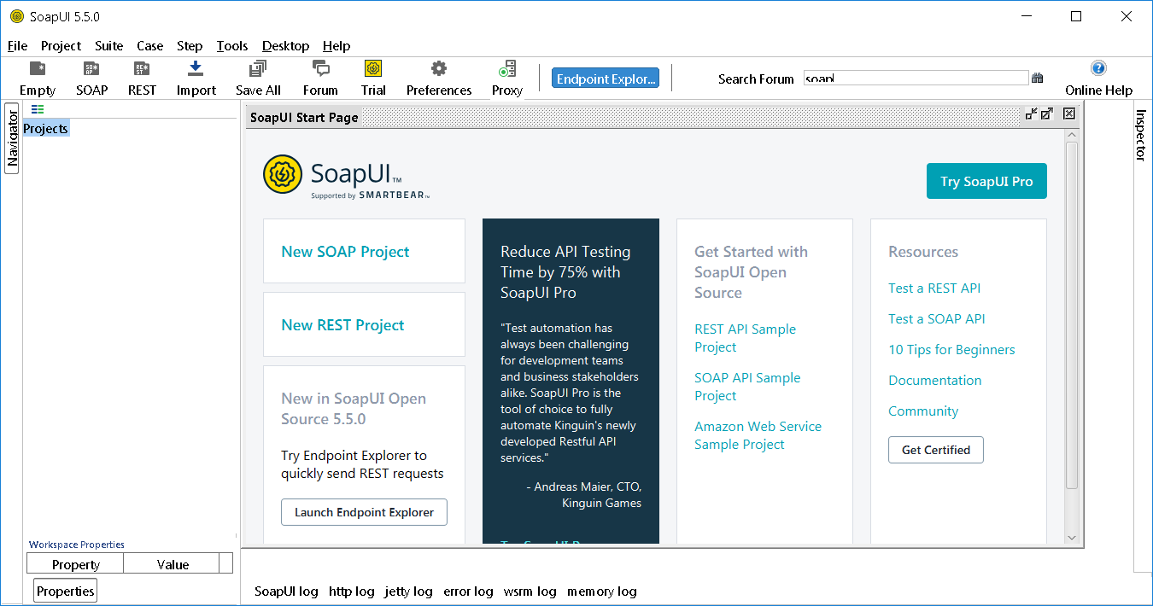
SoapUI

Slide 35
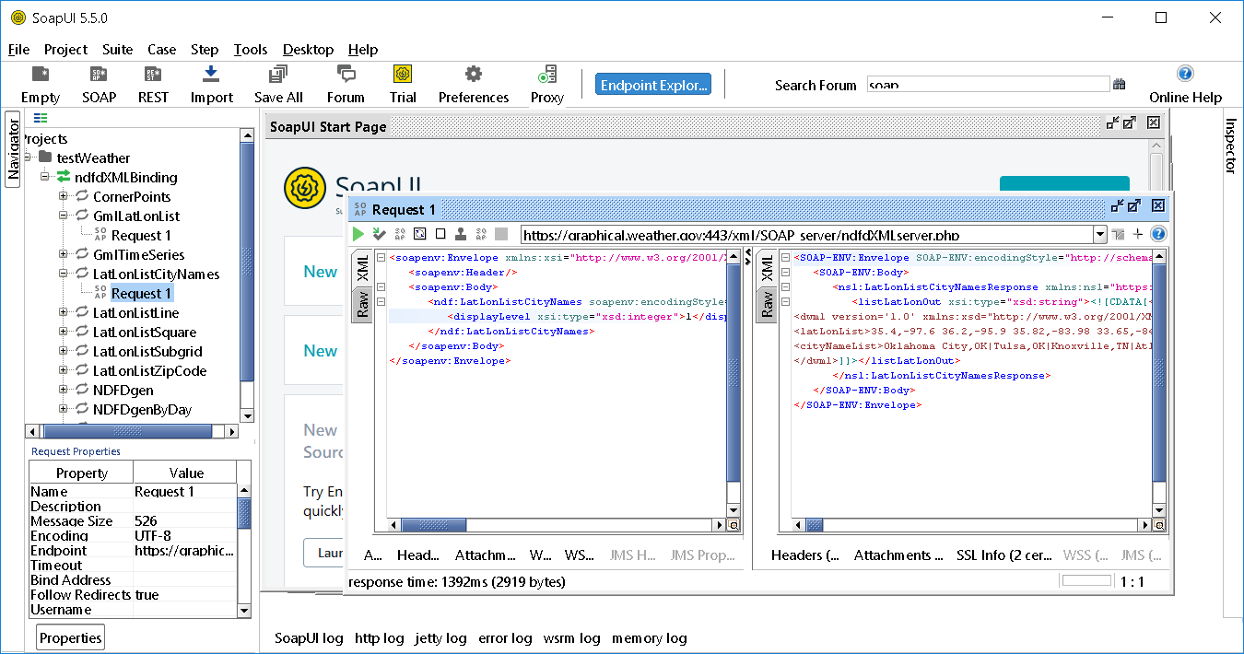
Testing Arizona Weather latl.onListCityNames

Slide 36
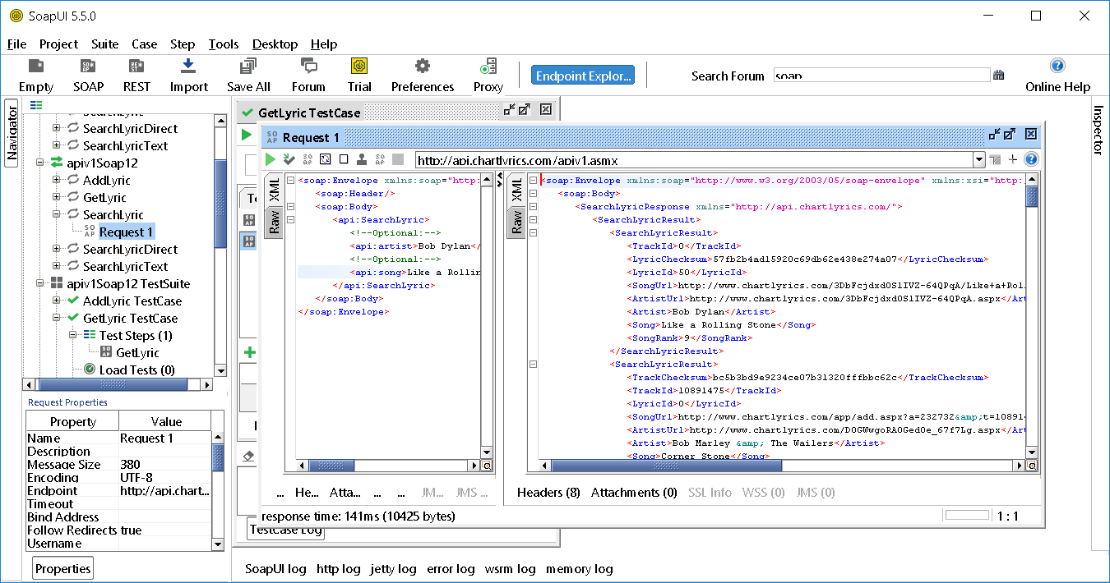
Testing Music Lyrics searchLyrics

Slide 37
EX: Programming a Web Service Client using Apache SOAP library
Once you have the specification of the service you can invoke it.
Tasks:
  Specify the URL of service.
  Setup SOAP encoding specification.
  Set service locator parameters.
  Create parameter vector (values to pass with service call).
  Invoke the service.
  Process the response – success OR failure.

Slide 38
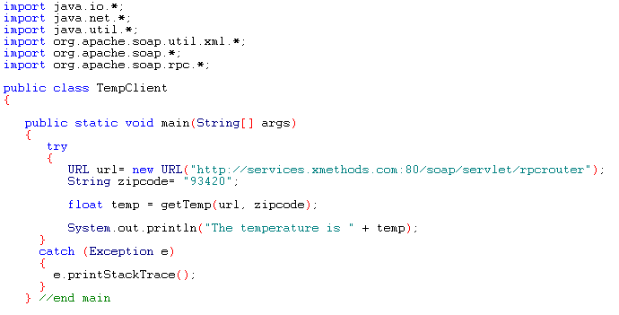
Web Service Client - 2
URL of service object

Slide 39
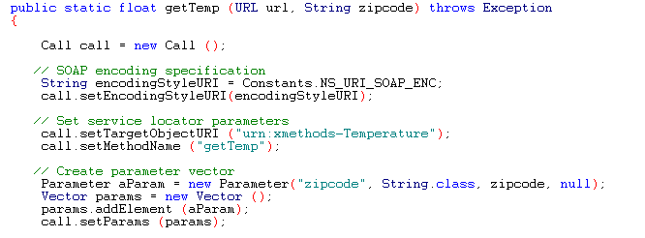
Web Service Client - 3

Slide 40
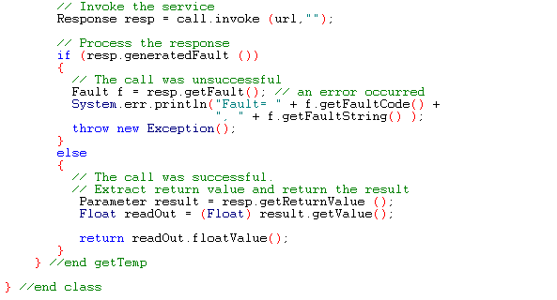
Web Service Client - 4

Slide 41
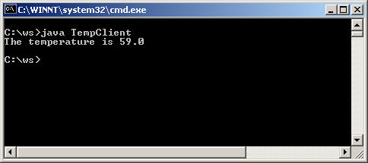
Compiling & Running
Compile the client program :
  java TempClient.java
SOAP Server:
  The web service is available at xmethods.
SOAP client:

Slide 42
Example Web Services
Google maps etc
Amazon
Social Media (Facebook, Twitter, Flickr, Del.icio.us, youtube etc)
Look at Netbeans/Visual Studio etc
Currency exchange conversion
Traffic reports
Weather reports
MP3 music finder
http://www.programmableweb.com/apis

Slide 43
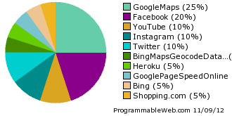
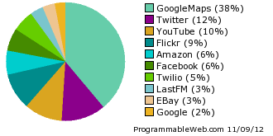
Top Ten Web Service APIs (last 2 weeks/all time)

Slide 44
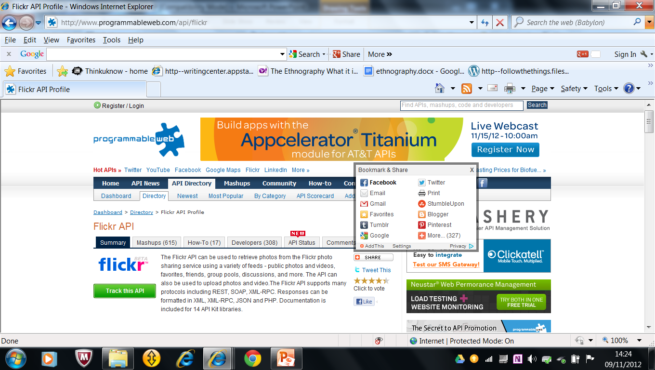

Flickr

Slide 45
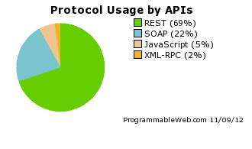
Top Protocol

Slide 46
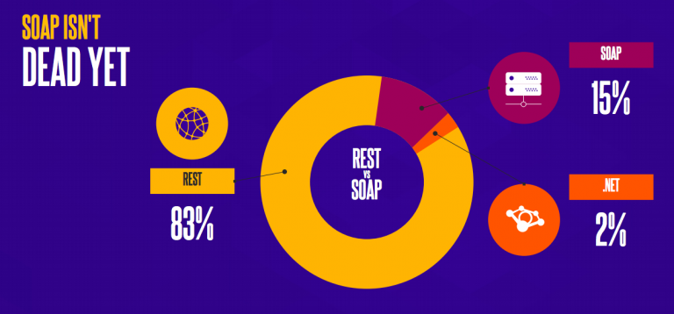
Soap not dead yet (2017)
According to this year’s report, one area that continues to come up year after year is the balance of power between SOAP and REST. Although REST dominates the scene, there is still a decent percentage SOAP APIs out there that can’t be ignored – at least 15% based on Cloud Elements’ experience.
https://jaxenter.com/state-of-api-integration-report-136342.html

Slide 47
Review - 1
Web Services
Conceptual Model of Web Services
Web Service Protocol Hierarchy
Web Service Protocols
Web Service Software Architecture
SOAP (Simple Object Access Protocol)
  SOAP Model
  SOAP Messages (XML Encoded)
  SOAP Request
  SOAP Response

Slide 48
Review - 2
Developing Web Services (Apache SOAP)

Slide 49
Additional Resources
Making mashups: http://www.programmableweb.com/howto

